Slide 1
Astrella Decembrica
Section Barcelona Team 2

Slide 2
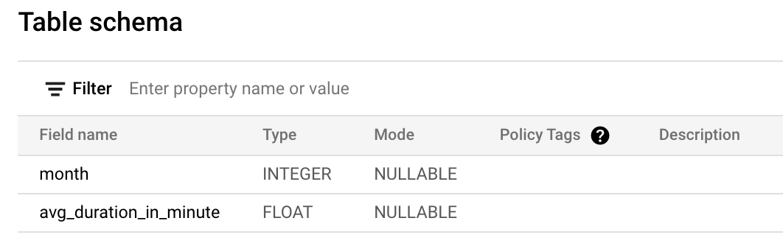
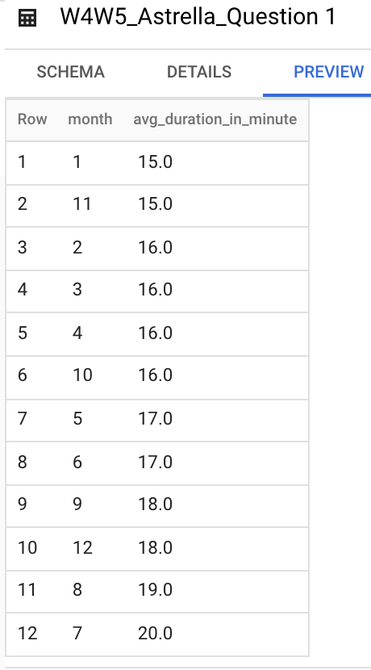
Question 1
Average amount of duration in minutes (per month) start from 2014-2017.
Expected output:
Month
Average (in minute)

Slide 3
Question 1 SQL Syntax
SELECT
EXTRACT(month FROM start_date) AS month,
ROUND(AVG(duration_sec/60)) AS avg_duration_in_minute
FROM `bigquery-public-data.san_francisco_bikeshare.bikeshare_trips`
WHERE start_date BETWEEN '2014-01-01' AND '2017-12-31'
GROUP BY month
ORDER BY month;

Slide 4
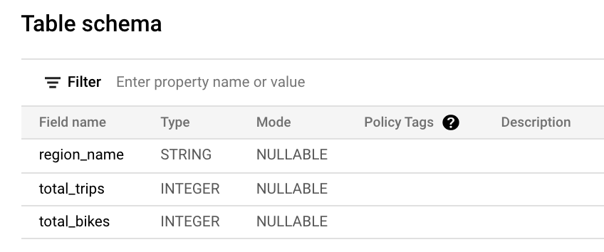
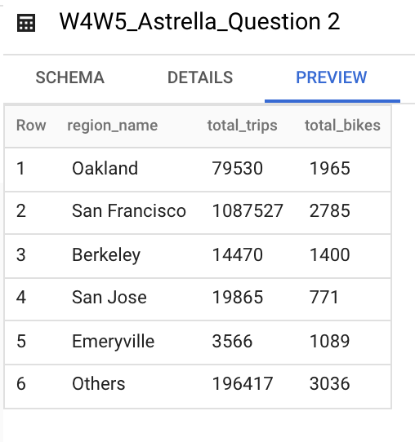
Question 2
Total trips and total number of unique bikes grouped by region name (2014-2017).
Expected output:
Region name
Total trips
Total bikes

Slide 5
Question 2 SQL Syntax
SELECT
CASE WHEN regions.name IS NULL THEN 'Others' ELSE regions.name END AS region_name,
COUNT(trips.trip_id) AS total_trips,
COUNT(DISTINCT trips.bike_number) AS total_bikes
FROM `bigquery-public-data.san_francisco_bikeshare.bikeshare_trips` AS trips
LEFT JOIN `bigquery-public-data.san_francisco_bikeshare.bikeshare_station_info` AS station_info
ON trips.start_station_id = station_info.station_id
LEFT JOIN `bigquery-public-data.san_francisco_bikeshare.bikeshare_regions` AS regions
ON regions.region_id = station_info.region_id
WHERE start_date BETWEEN '2014-01-01' AND '2017-12-31'
GROUP BY regions.name;

Slide 6
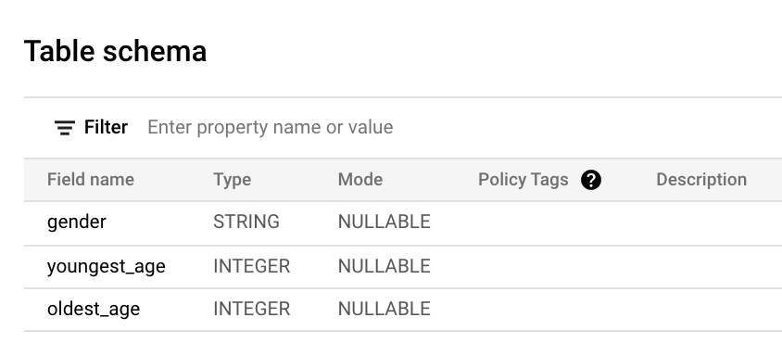
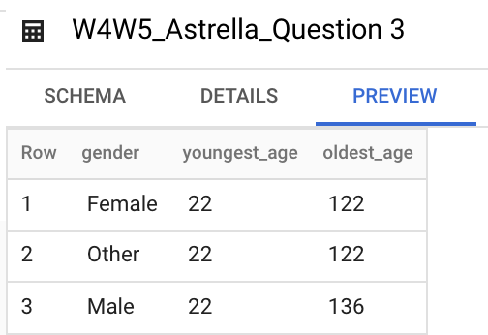
Question 3
The youngest and the oldest age of the members, for each gender. Assuming the year is 2022.
Expected output:
Gender
Youngest age
Oldest age

Slide 7
Question 3 SQL Syntax
WITH age_by_gender AS
(SELECT member_gender AS gender,
MIN(2022 - member_birth_year) AS youngest_age,
MAX(2022 - member_birth_year) AS oldest_age
FROM `bigquery-public-data.san_francisco_bikeshare.bikeshare_trips` AS trips
GROUP BY 1)
SELECT *
FROM age_by_gender
WHERE gender IS NOT NULL;

Slide 8
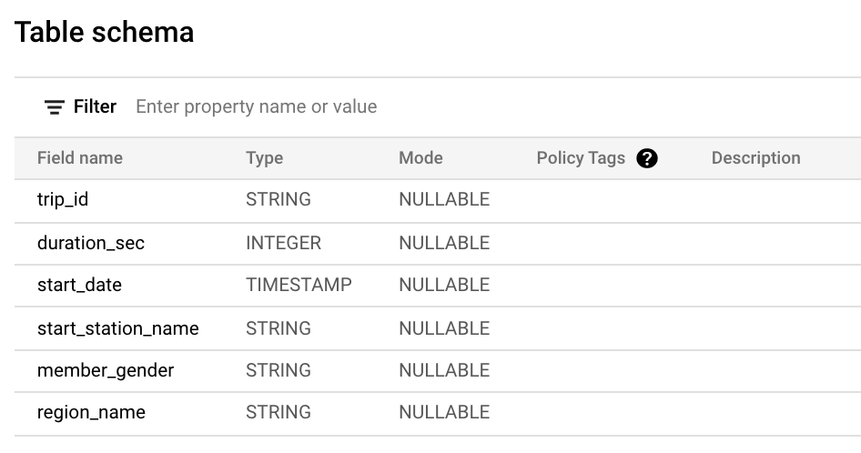
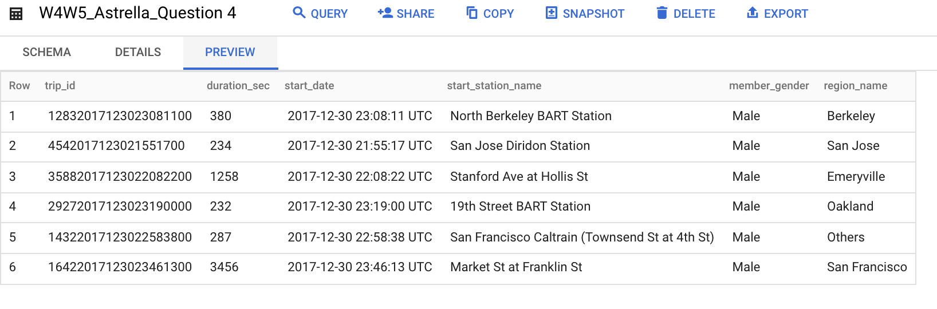
Question 4
Latest departure trip (2014-2017) in each region with detail below:
Trip_id
Duration_sec
Start_date
Start_station_name
Member_gender
Region_name

Slide 9
Question 4 SQL Syntax
WITH trip_detail AS
( SELECT trips.trip_id,
trips.duration_sec,
trips.start_date,
trips.start_station_name,
CASE WHEN trips.member_gender IS NULL THEN 'Others' ELSE trips.member_gender END AS member_gender,
CASE WHEN regions.name IS NULL THEN 'Others' ELSE regions.name END AS region_name,
ROW_NUMBER () OVER(PARTITION BY regions.name ORDER BY trips.start_date DESC) AS row_numbers
FROM `bigquery-public-data.san_francisco_bikeshare.bikeshare_trips` AS trips
LEFT JOIN `bigquery-public-data.san_francisco_bikeshare.bikeshare_station_info` AS station_info
ON trips.start_station_id = station_info.station_id
LEFT JOIN `bigquery-public-data.san_francisco_bikeshare.bikeshare_regions` AS regions
ON regions.region_id = station_info.region_id
WHERE start_date BETWEEN '2014-01-01' AND '2017-12-31')
SELECT * EXCEPT (row_numbers)
FROM trip_detail
WHERE row_numbers = 1;

Slide 10
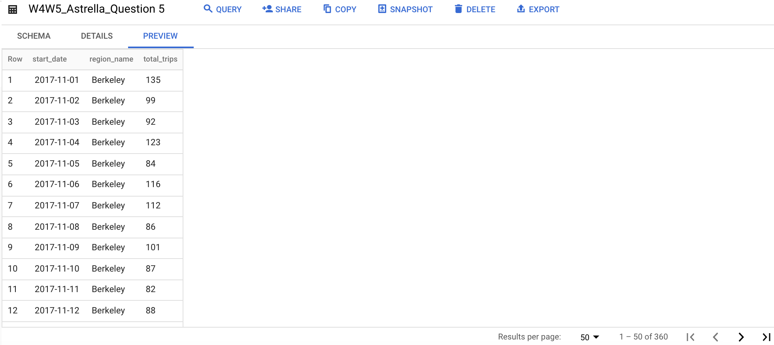
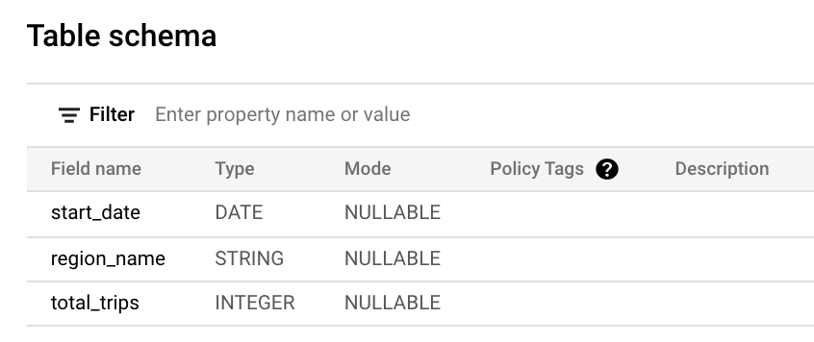
Question 5
Month to Date of total trips in each region, breakdown by date (Nov’17 - Dec’17). Expected output:
Start date (in date format)
Region name
Total trips (in cumulative)

Slide 11
Question 5 SQL Syntax
WITH temp_table AS
(
SELECT
DISTINCT (EXTRACT(date FROM trips.start_date)) AS start_date,
CASE WHEN regions.name IS NULL THEN 'Others' ELSE regions.name END AS region_name,
trips.trip_id
FROM `bigquery-public-data.san_francisco_bikeshare.bikeshare_trips` AS trips
LEFT JOIN `bigquery-public-data.san_francisco_bikeshare.bikeshare_station_info` AS info
ON trips.start_station_id = info.station_id
LEFT JOIN `bigquery-public-data.san_francisco_bikeshare.bikeshare_regions` AS regions
ON info.region_id = regions.region_id
WHERE start_date BETWEEN '2017-11-01' AND '2017-12-31'
)
SELECT DISTINCT start_date,
region_name,
COUNT(temp_table.trip_id) OVER (PARTITION BY region_name, start_date ORDER BY start_date ASC) AS total_trips
FROM temp_table;

Slide 12
ADVANCED ASSIGNMENT

Slide 13
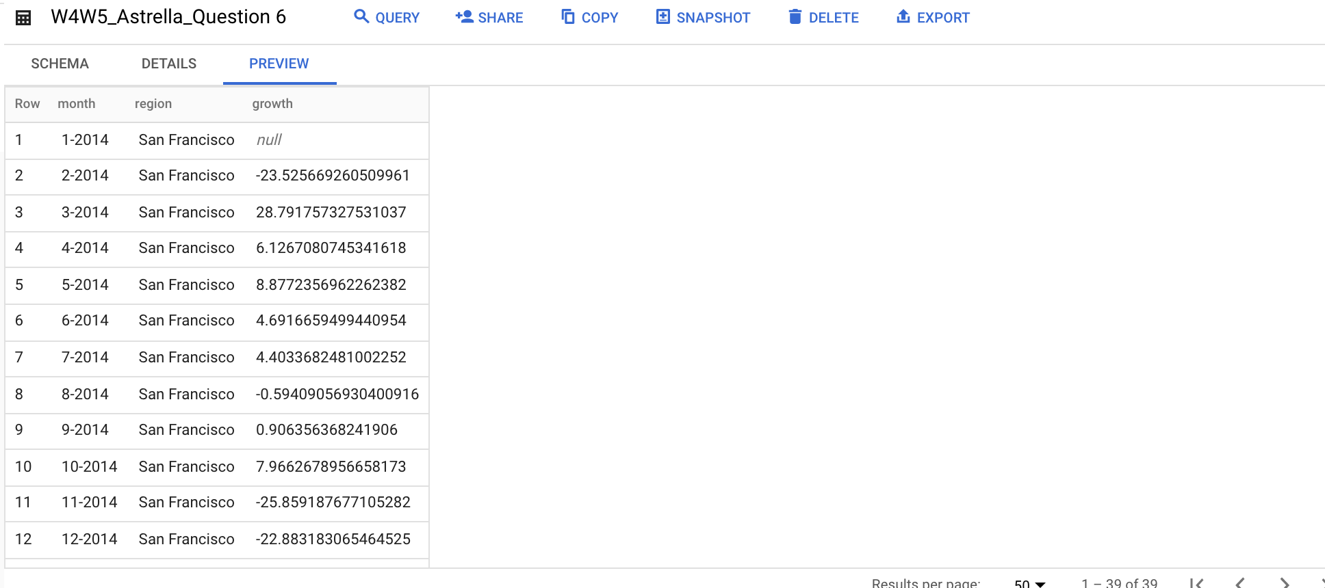
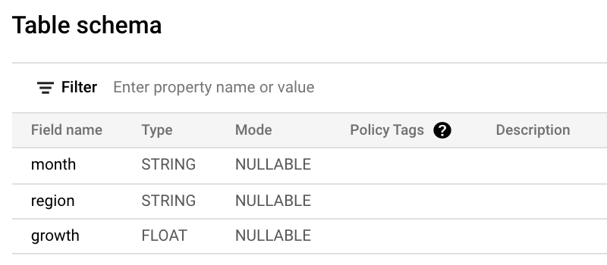
Question 6
Monthly growth of trips in percentage, order by time descendingly. From region which has the highest total number of trips (2014-2017). Expected output:
Month
Region
Growth (%)

Slide 14
Question 6 SQL Syntax
#Let's find out which region has the highest total number of trips
SELECT CASE WHEN regions.name IS NULL THEN 'Others' ELSE regions.name END AS region,
COUNT(trips.trip_id) AS total_trips
FROM `bigquery-public-data.san_francisco_bikeshare.bikeshare_trips` AS trips
LEFT JOIN `bigquery-public-data.san_francisco_bikeshare.bikeshare_station_info` AS info
ON trips.start_station_id = info.station_id
LEFT JOIN `bigquery-public-data.san_francisco_bikeshare.bikeshare_regions` AS regions
ON info.region_id = regions.region_id
WHERE start_date BETWEEN '2014-01-01' AND '2017-12-31'
GROUP BY 1;
#Data shows that San Francisco has the highest total number of trips from 2014 to 2017

Slide 15
#Then we calculated the growth rate of San Francisco
WITH temp AS
( SELECT DATE(DATE_TRUNC(trips.start_date, month)) AS date,
regions.name AS region,
COUNT(trips.trip_id) AS total_trips,
FROM `bigquery-public-data.san_francisco_bikeshare.bikeshare_trips` AS trips
LEFT JOIN `bigquery-public-data.san_francisco_bikeshare.bikeshare_station_info` AS info
ON trips.start_station_id = info.station_id
LEFT JOIN `bigquery-public-data.san_francisco_bikeshare.bikeshare_regions` AS regions
ON info.region_id = regions.region_id
WHERE trips.start_date BETWEEN '2014-01-01' AND '2017-12-31'
AND regions.name = 'San Francisco'
GROUP BY 1,2),

Slide 16
temp2 AS
( SELECT CONCAT(EXTRACT(month FROM date), '-', EXTRACT(year FROM date)) AS month,
region,
total_trips,
LAG(total_trips) OVER(PARTITION BY region ORDER BY date) AS prev_total_trips
FROM temp),
temp3 AS
( SELECT *,
((total_trips - prev_total_trips)/prev_total_trips)*100 AS growth
FROM temp2)
SELECT * EXCEPT (total_trips, prev_total_trips)
FROM temp3;

Slide 17
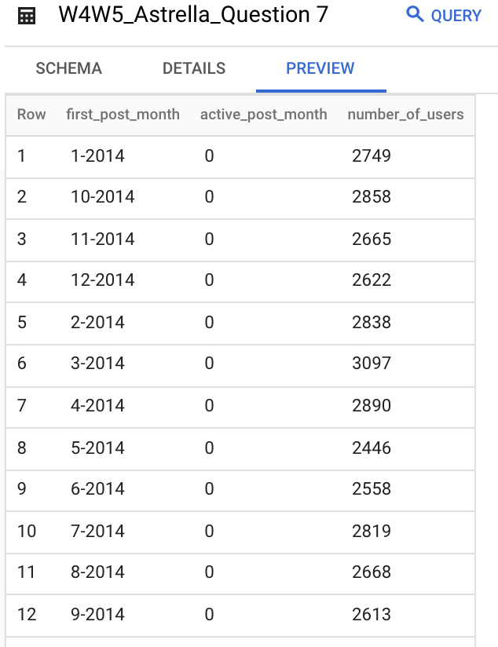
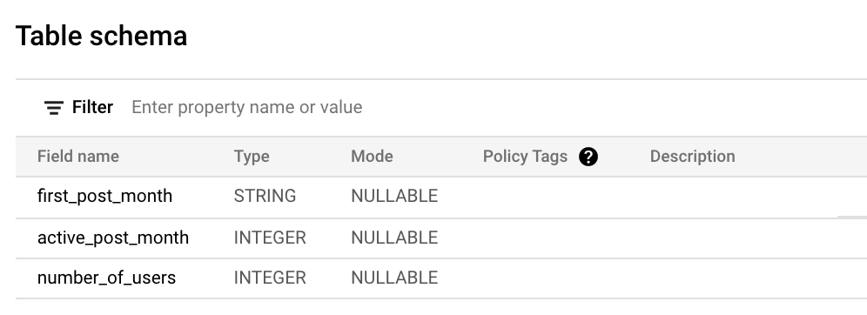
Question 7
Monthly retention cohort in 2014

Slide 18
Question 5 SQL Syntax
WITH temp AS
( SELECT author AS user,
MIN(DATE(DATE_TRUNC(time_ts, MONTH))) AS cohort_month
FROM `bigquery-public-data.hacker_news.stories`
GROUP BY 1),
temp2 AS
( SELECT act.author AS user,
DATE_DIFF(DATE(DATE_TRUNC(time_ts, MONTH)), temp.cohort_month,MONTH) AS month_number
FROM `bigquery-public-data.hacker_news.stories` AS act
LEFT JOIN temp
ON act.author = temp.user
WHERE DATE_TRUNC(temp.cohort_month,month) BETWEEN '2014-01-01' AND '2014-12-31'
AND DATE_TRUNC(time_ts,month) BETWEEN '2014-01-01' AND '2014-12-31'
GROUP BY 1,2),

Slide 19
temp3 AS
( SELECT cohort_month,
COUNT(1) AS num_users
FROM temp
GROUP BY 1
ORDER BY 1 ),
temp4 AS
( SELECT
temp.cohort_month,
temp2.month_number,
COUNT(1) AS num_users
FROM temp2
LEFT JOIN temp ON temp2.user = temp.user
GROUP BY 1, 2),

Slide 20
temp5 AS
( SELECT
CONCAT(EXTRACT(month FROM temp4.cohort_month), '-', EXTRACT(year FROM temp4.cohort_month)) AS first_post_month,
temp3.num_users AS cohort_size,
temp4.month_number AS active_post_month,
temp4.num_users AS number_of_users,
CAST(temp4.num_users AS decimal)/ temp3.num_users AS percentage
FROM temp4
LEFT JOIN temp3 ON temp4.cohort_month = temp3.cohort_month
WHERE temp4.cohort_month IS NOT NULL
ORDER BY 1,2,3)
SELECT * EXCEPT (cohort_size, percentage)
FROM temp5

Slide 21
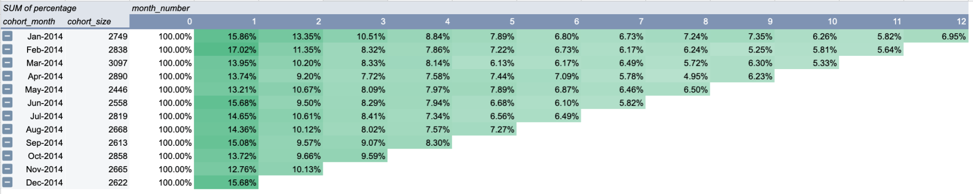
Insights (Visualization)
During the year 2014, there was no significant increase in retention month to month. The number, in general, was not satisfying since the percentage of users who came back the first month after their first post on the website fell only within the range of 12-17% out of 100% and this number kept decreasing month to month. It is necessary to find out the reason behind the downtrend of users retention in 2014 and to take action to improve the website’s stickiness.

